Slide 1

Database Technologies - MySQL
A day without new knowledge is a lost day.
Before we start DBT module.
Which module(s) you have completed?
iet
If A and a, B and b, C and c etc. are treated in the same way then it is case-insensitive. MySQL is case-insensitive
In this module we are going to learn SQL, PL/SQL and NoSQL(MongoDB)

Slide 2
Introduction
If anyone who wants to develop a good application
then he should have the knowledge three major components.
They are (3-Layer Architecture).
Front End (Presentation Layer [ UI ] )
Middle Layer (Application Layer [ Server Application and Client Application ] )
Back End (Data Layer/ Data Access Layer [ Flat Files / (OO)RDBMS / NoSQL ] )
So as a programmer:
a person should understand and be able to interact with a database is must, so than the data which is collected from the UI is processed and stored permanently. (eg. Any management systems, set top box, washing machine, mobile application etc.).

Slide 3
Introduction
Why do we need databases (Use Case)?
We need databases because they organize data in a manner which allows us to store, query, sort, and manipulate data in various ways. Databases allow us to do all this things.
Many companies collects data from different resource (like Weather data, Geographical data, Finance data, Scientific data, Transport data, Cultural data, etc.)

Slide 4
What is Relation and Relationship?

Slide 5
relation and relationship?
Relation (in Relational Algebra "R" stands for relation): In Database, a relation represents a table or an entity than contain attributes.
Relationship: In database, relationship is that how the two entities are connected to each other, i.e. what kind of relationship type they hold between them.
Primary/Foreign key is used to specify this relationship.
Remember:
Foreign Key is also know as
Reference
Referential key.
Note:
Table - The physical instantiation of a relation in the database schema.
Relation - A logical construct that organizes data into rows and columns.

Slide 6
File Systems is the traditional way to keep your data organized.
File System
vs
DBMS

Slide 7
file-oriented system
Create/Open an existing file
Reading from file
Writing to a file
Closing a file
File Anomalies
c:\employee.txt
c:\employee.txt
c:\employee.txt
c:\employee.txt
c:\employee.txt
1 suraj 4000
2 ramesh 6000
3 rajan 4500
. |
. |
. |
500 sam 3500
. |
. |
. |
1000 amit 2300
1 suraj 4000
2 ramesh 6000
3 rajan 4500
. |
. |
. |
500 sam 3500
. |
. |
1000 amit 2300
. |
. |
. |
2000 jerry 4500
. |
. |
1 suraj 4000
2 ramesh 6000
3 rajan 4500
. |
. |
. |
500 pankaj 3500
. |
. |
1000 amit 2300
. |
1000 amit 2300
. |
2000 jerry 4500
. |
. |
1 suraj 4000
2 ramesh 6000
3 rajan 4500
. |
. |
. |
pankaj 500 3500
. |
. |
1000 amit 2300
. |
1000 amit 2300
. |
jerry 2000 4500
. |
. |
1 suraj 4000
2 ramesh 6000
3 rajan 4500
. |
. |
. |
500 sam 3500
. |
. |
. |
. |
. |
1250 neel 4500

Slide 8
file-oriented system
Create/Open an existing file
Reading from file
Writing to a file
Closing a file
File Anomalies
c:\employee.txt
file attributes
file permissions
search employee with ID=1
1 suraj 4000
2 ramesh 6000
3 rajan 4500
. |
. |
. |
500 sam 3500
. |
. |
. |
1000 amit 2300
File Name
Type
Location
File permissions
Share permissions
1 suraj 4000
2 ramesh 6000
3 rajan 4500
. |
. |
. |
500 sam 3500
. |
. |
. |
1000 amit 2300

Slide 9
advantages of file-oriented system
The biggest advantage of file-based storage is that anyone can understand the system.
Advantage of File-oriented system
Backup: It is possible to take faster and automatic back-up of database stored in files of computer-based systems.
Data retrieval: It is possible to retrieve data stored in files in easy and efficient way.
Editing: It is easy to edit any information stored in computers in form of files.
Remote access: In computer-based systems, it is possible to access data remotely.
Sharing: Data stored in files of computer-based systems can be shared among multiple users at a same time.

Slide 10
disadvantage of file-oriented system
The biggest disadvantage of file-based storage is as follows.
Disadvantage of File-oriented system
Data redundancy: It is possible that the same information may be duplicated in different files. This leads to data redundancy results in memory wastage. (Suppose a customer having both kind of accounts- saving and current account. In such a situation a customers detail are stored in both the file, saving.txt- file and current.txt- file , which leads to Data Redundancy.)
Data inconsistency: Because of data redundancy, it is possible that data may not be in consistent state. (Suppose customer changed his/her address. There might be a possibility that address is changed in only one file (saving.txt) and other (current.txt) remain unchanged.)
Limited data sharing: Data are scattered in various files and also different files may have different formats (for example: .txt, .csv, .tsv and .xml) and these files may be stored in different folders so, due to this it is difficult to share data among different applications.
Data Isolation: Because data are scattered in various files, and files may be in different formats (for example: .txt, .csv, .tsv and .xml), writing new application programs to retrieve the appropriate data is difficult.
Data security: Data should be secured from unauthorized access, for example a account holder in a bank should not be able to see the account details of another account holder, such kind of security constraints are difficult to apply in file processing systems.

Slide 11
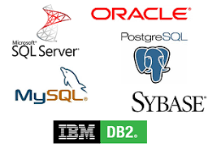
Relation Schema: A relation schema represents name of the relation with its attributes.
e.g. student (roll_no, name, address, phone and age) is relation schema for STUDENT
DBMS
The database management system (DBMS) is the software that interacts with end users, applications, and the database itself to store and analyze the data.
database: Is the collection of related data which is organized, database can store and retrieve large amount of data easily, which is stored in one or more data files by one or more users, it is called as structured data.
management system: is a software, designed to define, manipulate, retrieve and manage data in a database.
A database is an organized collection of structured information

Slide 12
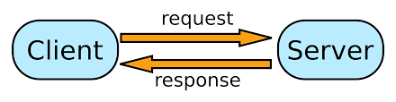


relational database management system?
A RDBMS is a database management system (DBMS) that is based on the relational model introduced by Edgar Frank Codd at IBM in 1970.
RDBMS supports
client/server Technology
Highly Secured
Relationship (PK/FK)

Slide 13
difference between dbms and rdbms
DBMS | RDBMS
There is no relationship between data in DBMS. | Data is present in multiple tables which can be related to each other.
DBMS has no support for distributed databases. | RDBMS supports distributed databases.
Normalization cannot be achieved. | Normalization can be achieved.
DBMS supports single user at a time. | RDBMS supports multiple users at a time.
Data Redundancy is common in DBMS. | Data Redundancy can be reduced in RDBMS.
DBMS provides low level of security during data manipulation. | RDBMS has high level of security during data manipulation.
PostgreSQL is the most popular pure ORDBMS. Some popular databases including Microsoft SQL Server, Oracle, and IBM DB2 also support objects and can be considered as ORDBMS.

Slide 14
relational model concepts
and
properties of relational table

Slide 15
relational model concepts
Relational model organizes data into one or more tables (or "relations") of columns and rows. Rows are also called records or tuples. Columns are also called attributes.
Tables − In relational model, relations are saved in the form of Tables. A table has rows and columns.
Attribute − Attributes are the properties that define a relation. e.g. (roll_no, name, address, phone and age)
Tuple − A single row of a table, which contains a single record for that relation is called a tuple.
Relation schema − A relation schema describes the relation name (table name) with its attribute (columns) names.
Attribute domain − Every attribute has some pre-defined datatypes, known as attribute domain.
Relation key − Each row has one or more attributes, known as relation key, which can identify the row in the relation (table) uniquely.
e.g. student(roll_no, name, address, phone and age) is relation schema for student relation.

Slide 16
properties of relational table
ID | job | firstName | DoB | salary
1 | manager | Saleel Bagde | yyyy-mm-dd | ●●●●●●
3 | salesman | Sharmin | yyyy-mm-dd | ●●●●●●
4 | accountant | Vrushali | yyyy-mm-dd | ●●●●●●
2 | salesman | Ruhan | yyyy-mm-dd | ●●●●●●
5 | 9500 | manager | yyyy-mm-dd | ●●●●●●
5 | Salesman | Rahul Patil | yyyy-mm-dd | ●●●●●●
Domain refers to all the valid values which a column may contain.
Relational tables have six properties:
Values are atomic.
Column values are of the same kind. (Attribute Domain: Every attribute has some pre-defined datatypes, known as attribute domain.)
Each row is unique.
The sequence of columns is insignificant – (unimportant).
The sequence of rows is insignificant – (unimportant).
Each attribute/column must have a unique name.

Slide 17

What is data?

Slide 18
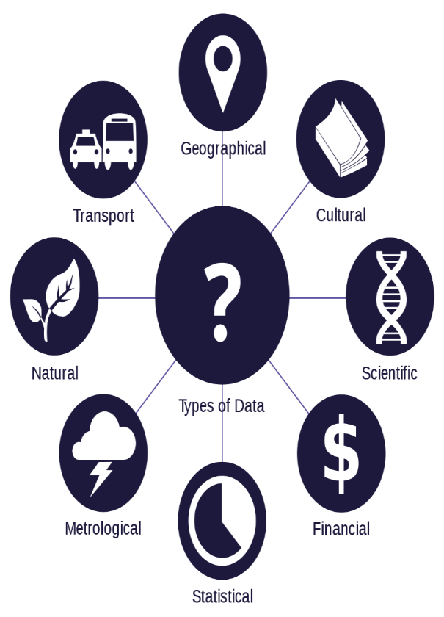
what is data?
Data is any facts that can be stored and that can be processed by a computer.
Data can be in the form of Text or Multimedia
e.g.
number, characters, or symbol
images, audio, video, or signal

Slide 19
What is Entity Relationship Diagram?

Slide 20
Entity Relationship Diagram (ER Diagram)
Use E-R model to get a high-level graphical view to describe the "ENTITIES" and their "RELATIONSHIP"
The basic constructs/components of ER Model are
Entity, Attributes and Relationships.

Slide 21
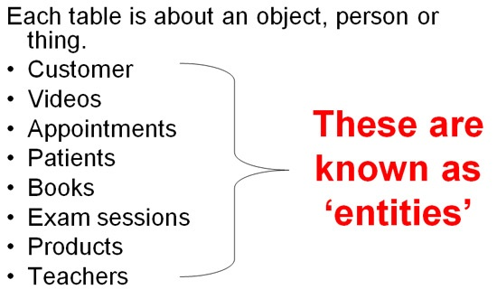
An entity can be a real-world object.
What is Entity?

Slide 22
entity
In relation to a database , an entity is a
Person(student, teacher, employee, department, …)
Place(classroom, building, …) --a particular position or area
Thing(book, computer, lab equipment, …) --an object that is not named
Concept(course, batch, student’s attendance, …) -- an idea,
about which data can be stored. All these entities have some attributes or properties that give them their identity.
Every entity has its own characteristics.

Slide 23
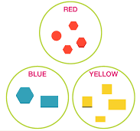
What is an Attribute?
Attributes are the properties that define a relation.
e.g. student(ID, firstName, middleName, lastName, city)
Entity
Attribute

Slide 24
attributes
In Entity Relationship(ER) Model attributes can be classified into the following types.
Simple/Atomic and Composite Attribute
Single Valued and Multi Valued attribute
Stored and Derived Attributes
Complex Attribute

Slide 25
attributes
Simple / Atomic Attribute --VS-- Composite Attribute
(Can’t be divided further) (Can be divided further)
Single Value Attribute --VS-- Multi Valued Attribute
(Only One value) (Multiple values)
Stored Attribute --VS-- Derived Attribute
(Only One value) (Virtual)
Complex Attribute
(Composite & Multivalued)
Atomic Attribute: An attribute that cannot be divided into smaller independent attribute is known as atomic attribute.
e.g. ID’s, age, gender, zip, marital status cannot further divide.
Single Value Attribute: An attribute that has only single value is known as single valued attribute.
e.g. manufactured part can have only one serial number, voter card, blood group, price, quantity, branch can have only one value.
Stored Attribute: The stored attribute are such attributes which are already stored in the database and from which the value of another attribute is derived.
e.g. (HRA, DA…) can be derive from salary, age can be derived from DoB, total marks or average marks of a student can be derived from marks.

Slide 26
Composite VS Multi Valued Attribute

Slide 27

composite / multi valued attributes
Composite Attribute
Person Entity
Name attribute: ( firstName, middleName, and lastName )
PhoneNumber attribute: ( countryCode, cityCode, and phoneNumber )
Multi Valued Attribute
Person Entity
Hobbies attribute: [ reading, hiking, hockey, skiing, photography, . . . ]
SpokenLanguages attribute: [ Hindi, Marathi, Gujarati, English, . . . ]
Degrees attribute: [ 10th , 12th, BE, ME, PhD, . . . ]
emailID attribute: [ saleel@gmail.com, salil@yahoomail.com, . . . ]

Slide 28
What is an Prime, Non-Prime Attribute?

Slide 29
attributes
Prime attribute (Entity integrity)
An attribute, which is a part of the prime-key (candidate key), is known as a prime attribute.
Non-prime attribute
An attribute, which is not a part of the prime-key (candidate key), is said to be a non-prime attribute.

Slide 30
Entity Relationship Diagram Symbols

Slide 31
erdplus.com
www.draw.io
entity relationship diagram symbols
Attribute
Composite Attribute
Key Attribute
Strong Entity
Weak Entity
Derived Attribute
Weak Relationship
Relationship
Multivalued Attribute

Slide 32
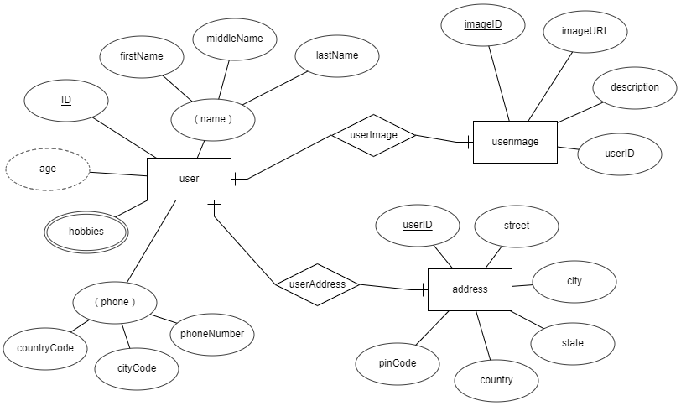
entity relationship diagram
DoB

Slide 33
What is a degree, cardinality, domain and union in database?
Degree d(R) / Arity: Total number of attributes/columns present in a relation/table is called degree of the relation and is denoted by d(R).
Cardinality |R|: Total number of tuples/rows present in a relation/table, is called cardinality of a relation and is denoted by |R|.
Domain: Total range of accepted values for an attribute of the relation is called the domain of the attribute. (Data Type)
Union Compatibility: Two relations R and S are set to be Union Compatible to each other if and only if:
They have the same degree d(R).
Domains of the respective attributes should also be same.

Slide 34
Data integrity refers to the correctness and completeness of data.
A domain constraint and types of data integrity constraints
Domain Constraint = data type + Constraints (not null/unique/primary key/foreign key/check/default)
e.g. custID INT, constraint pk_custid PRIMARY KEY(custID)
Three types of integrity constraints: entity integrity, referential integrity and domain integrity:
Entity integrity: Entity Integrity Constraint is used to ensure the uniqueness of each record the table. There are primarily two types of integrity constraints that help us in ensuring the uniqueness of each row, namely, UNIQUE constraint and PRIMARY KEY constraint.
Referential integrity: Referential Integrity Constraint ensures that there always exists a valid relationship between two tables. This makes sure that if a foreign key exists in a table relationship then it should always reference a corresponding value in the second table or it should be null.
Domain integrity: A domain is a set of values of the same type. For example, we can specify if a particular column can hold null values or not, if the values have to be unique or not, the data type or size of values that can be entered in the column, the default values for the column, etc..

Slide 35
what is a domain constraint in database?
Domain Constraint = data type + Constraints (NOT NULL / UNIQUE / PRIMARY KEY / FOREIGN KEY / CHECK / DEFAULT)
Data Domain refers to all the valid values which a column may contain and can be done by giving data type to the column.

Slide 36
Keys are used to establish relationships between tables and also to uniquely identify any record in the table.
types of Keys?
r = Employee(EmployeeID, FullName, job, salary, PAN, DateOfBirth, emailID, deptno)
Candidate Key: are individual columns in a table that qualifies for uniqueness of all the rows. Here in Employee table EmployeeID, PAN or emailID are Candidate keys.
Primary Key: is the columns you choose to maintain uniqueness in a table. Here in Employee table you can choose either EmployeeID, PAN or emailID columns, EmployeeID is preferable choice.
Alternate Key: Candidate column other the primary key column, like if EmployeeID is primary key then , PAN or emailID columns would be the Alternate key.
Super Key: If you add any other column to a primary key then it become a super key, like EmployeeID + FullName is a Super Key.
Composite Key: If a table do not have any single column that qualifies for a Candidate key, then you have to select 2 or more columns to make a row unique. Like if there is no EmployeeID, PAN or emailID columns, then you can make FullName + DateOfBirth as Composite key. But still there can be a narrow chance of duplicate row.

Slide 37
Common relationships

Slide 38

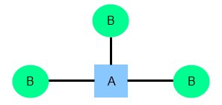
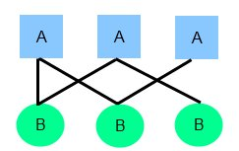
relationships
There are three degrees of relationship
one-to-one (1:1)
one-to-many (1:M)
many-to-many (M:N)

Slide 39
one-to-one relationship

Slide 40
one-to-one relationship
A one-to-one relationship between two tables means that a row in one table can only relate to zero/one row in the table on the other side of their relationship. This is the least common database relationship.
A one-to-one relationship is a type of cardinality that refers to the relationship between two entities R and S in which one element of entity R may only be linked to zero/one element of entity S, and vice versa.
Country-1
Capital-1
Country-1
Capital-1
Country-2
one-to-one relationship
Capital-2
Country-2
Capital-2
=
Country-3
Capital-3
Country-3
Capital-3

Slide 41
one-to-many relationship

Slide 42
one-to-many relationship
A one-to-many relationship between two tables means that a row in one table can have zero or more row in the table on the other side of their relationship.
a one-to-many relationship is a type of cardinality that refers to the relationship between two entities R and S in which an element of R may be linked to many elements of S, but a member of S is linked to only one element of R.
Customer-1
Order-1
Customer-1
Order-1
Customer-2
Order-1
Customer-2
Order-1
one-to-many relationship
Customer-3
Order-2
=
Customer-2
Order-2
Customer-4
Order-1
Customer-3
Order-1
Customer-5
Order-2
Customer-3
Order-2
Order-3
Customer-3
Order-3
Order-1
Customer-4
Order-1

Slide 43
many-to-one relationship

Slide 44
many-to-many relationship

Slide 45
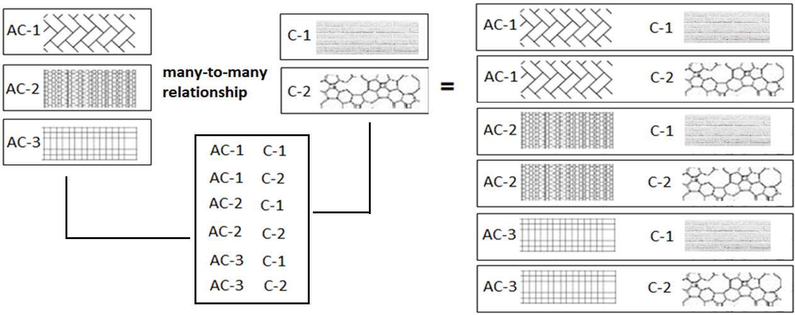
many-to-many relationship
A many-to-many relationship is a type of cardinality that refers to the relationship between two entities R and S in which R may contain a parent instance for which there are many children in S and vice versa.
=
=

Slide 46

MySQL
MySQL is the most popular Open Source
Relational Database Management System.
MySQL was created by a Swedish company - MySQL AB that was founded in 1995. It was acquired by Sun Microsystems in 2008; Sun was in turn acquired by Oracle Corporation in 2010.
When you use MySQL, you’re actually using at least two programmes. One program is the MySQL server (mysqld.exe) and other program is MySQL client program (mysql.exe) that connects to the database server.

Slide 47
What is SQL?

Slide 48
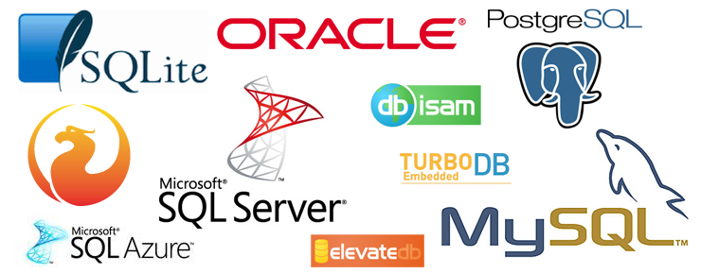
what is sql?
SQL (Structured Query Language) is a database language designed and developed for managing data in relational database management systems (RDBMS). SQL is common language for all Relational Databases.

Slide 49
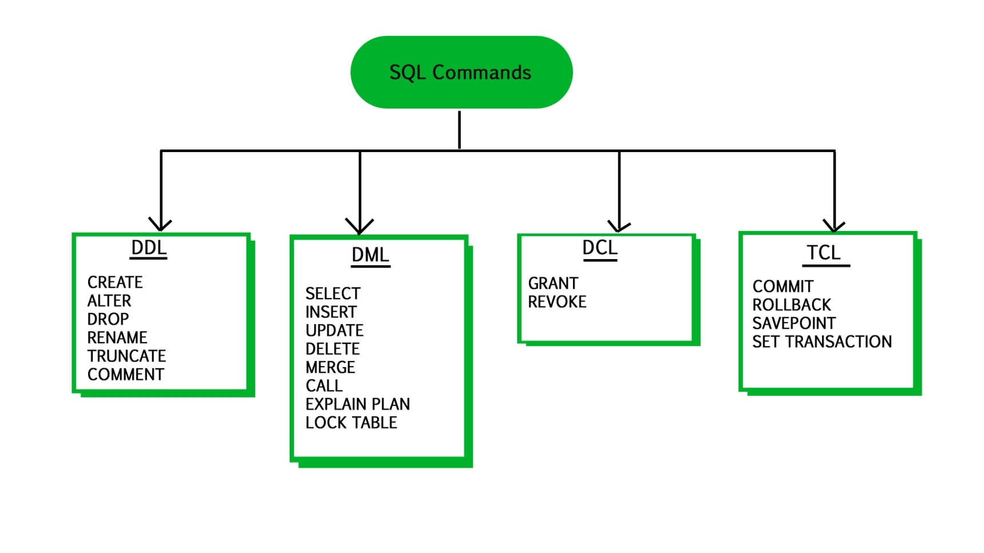
what is sql?
Remember:
A NULL value is not treated as a blank or 0. Null or NULL is a special marker used in Structured Query Language to indicate that a data value does not exist in the database.
Degree d(R): Total no. of attributes/columns present in a relation/table is called degree of the relation and is denoted by d(R).
Cardinality |R|: Total no. of tuples present in a relation or Rows present in a table, is called cardinality of a relation and is denoted by |R|.

Slide 50
comments in mysql
From a # character to the end of the line.
From a -- sequence to the end of the line.
From a /* sequence to the following */ sequence.

Slide 51
Login to MySQL

Slide 52
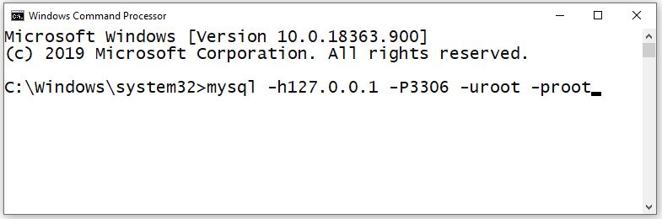
login
Default port for MySQL Server: 3306
C:\> mysql -hlocalhost -P3307 -uroot -p
C:\> mysql -h127.0.0.1 -P3307 -uroot -p [database_name]
C:\> mysql -h192.168.100.14 -P3307 -uroot -psaleel [database_name]
C:\> mysql --host localhost --port 3306 --user root --password=ROOT [database_name]
C:\> mysql --host=localhost --port=3306 --user=root --password=ROOT [database_name]

Slide 53
SHOW DATABASES

Slide 54
SHOW DATABASES Syntax
SHOW {DATABASES | SCHEMAS} [LIKE 'pattern' | WHERE expr]
SHOW SCHEMAS is a synonym for SHOW DATABASES.
SHOW DATABASES;
SHOW SCHEMAS;
SHOW DATABASES LIKE 'U%';
SHOW SCHEMAS LIKE 'U%';
NULL means “no database is selected”. Issue the USE dbName command to select the database.

Slide 55
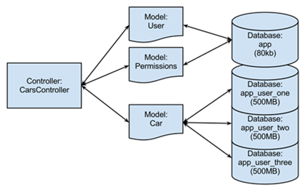
USE DATABASES
The USE db_name statement tells MySQL to use the db_name database as the default (current) database for subsequent statements. The database remains the default until the end of the session or another USE statement is issued.

Slide 56
USE DATABASES Syntax
USE db_name
Note:
USE, does not require a semicolon.
USE must be followed by a database name.
USE db1
\U db1

Slide 57
CREATE DATABASE

Slide 58
create database
CREATE DATABASE creates a database with the given name. To use this statement, you need the CREATE privilege for the database.
CREATE {DATABASE | SCHEMA} [IF NOT EXISTS] db_name
CREATE SCHEMA is a synonym for CREATE DATABASE.
CREATE DATABASE db1;
CREATE DATABASE IF NOT EXISTS db1;

Slide 59
DROP DATABASE
If the default database is dropped, the default database is unset (the DATABASE() function returns NULL).

Slide 60
drop database
DROP DATABASE drops all tables in the database and deletes the database. Be very careful with this statement! To use DROP DATABASE, you need the DROP privilege on the database.
DROP {DATABASE | SCHEMA} [IF EXISTS] db_name
DROP SCHEMA is a synonym for DROP DATABASE.
DROP DATABASE db1;
DROP DATABASE IF EXISTS db1;

Slide 61

"Live as if you were to die tomorrow.
Learn as if you were to live forever"

